Slide 1

Company Bankruptcy Analysis
Huynh Kim Hung

Slide 2
Table of contents
01
04
02
05
03
Project Goals
ML Model
Dataset Overview
Conclusion
EDA

Slide 3

01
Goals

Slide 4

Company Bankruptcy
Company bankruptcy happens when a company can't pay its debts, leading to asset liquidation to repay creditors and possibly halting operations.

Slide 5
Why study Historical Bankruptcy?
Risk Awareness
Industry Insight
Helps investors identify and reduce financial risks.
Reveals market trends and challenges for better business analysis.
Learning Opportunities
Strategic Guidance
Offers lessons to improve decision-making and avoid mistakes.
Provides struggling companies with strategies for recovery.

Slide 6
Project Goals
Purpose
Identify financial and operational factors that contribute to company bankruptcy.
Develop a predictive model to assess bankruptcy risk for companies.
Outcome
A machine learning model that accurately predicts bankruptcy.
Actionable insights into the financial indicators influencing a company's likelihood of bankruptcy.

Slide 7
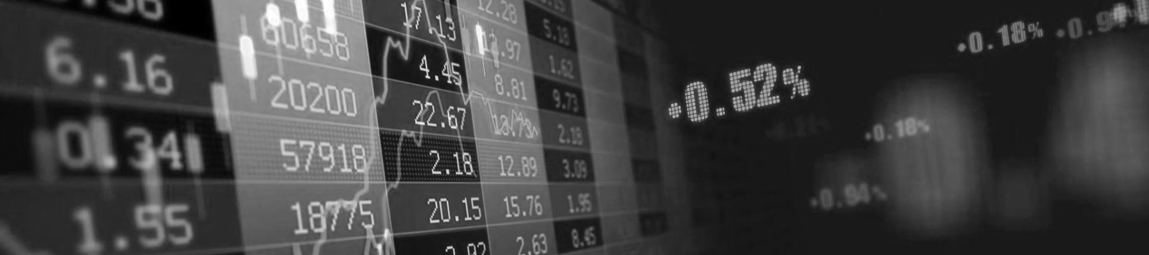
02
Dataset

Slide 8

The data were collected from the Taiwan Economic Journal for the years 1999 to 2009.
Company bankruptcy was defined based on the business regulations of the Taiwan Stock Exchange (TWSE).
Data collected includes company's bankrupted because of Dotcom Bubble (late 1990s and early 2000s) and Global Financial crisis (2007 - 2008).

Slide 9

The dataset includes the following columns:
Financial Indicators (95): Metrics such as total assets, liabilities, working capital, and revenue, etc.
Bankruptcy Status: Binary column indicating whether a company went bankrupt (1) or not (0).

Slide 10

03
EDA

Slide 11
Data Quality
Data dimension :
Number of Records : 6819
Number of Features : 96
Datatype of Features :
float64 93
int64 3
dtype: int64
Missing values :
Missing values not identified
Duplicated records :
Duplicated records not identified

Slide 12
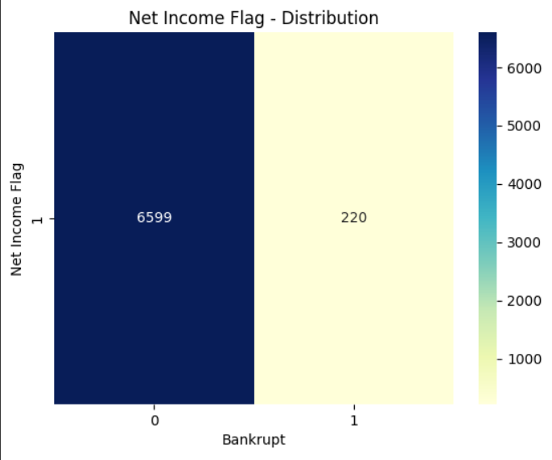
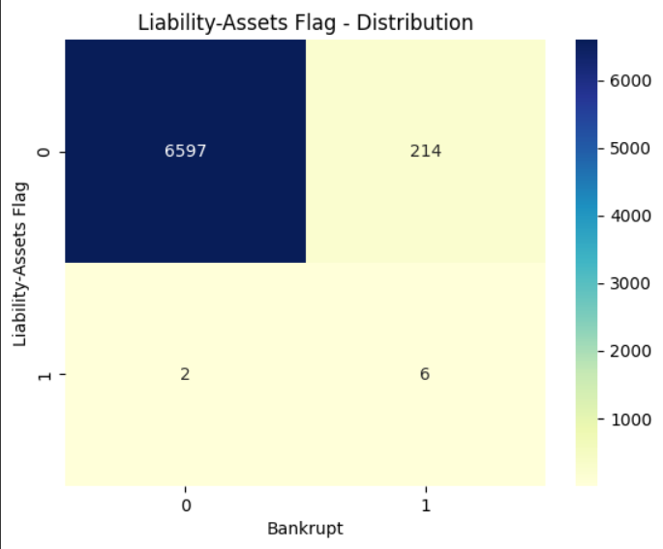
Categorical Columns Distribution
All the values in Net income flag are 1, so there is no use in retaining it in the model.
company_df.drop(['Net Income Flag'],axis = 1,inplace=True)

Slide 13
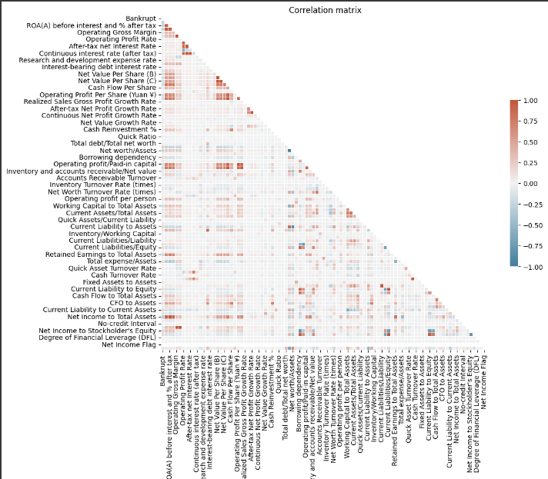
Correlation Analysis

Slide 14

Curse of Dimensionality
In the bankruptcy data we have has 90+ features. Analysing and building models using 90+ features is a time and resource consuming process.
Lets narrow down our analysis to limited columns, so we will use Predictive power score and Decision tree algorithm.

Slide 15
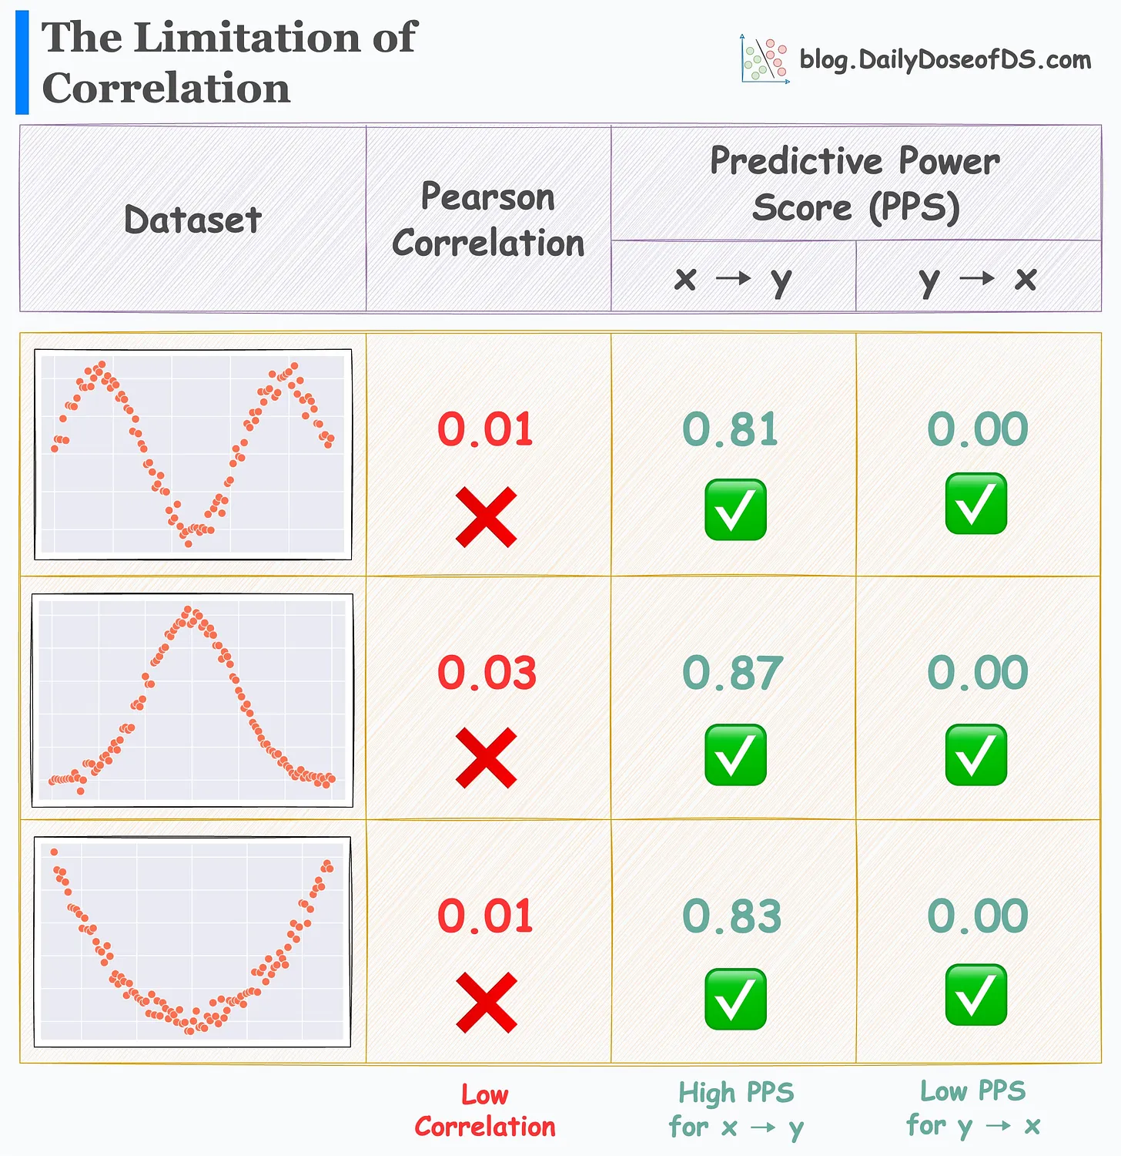
Predictive Power Score (PPS)
The PPS is an asymmetric, data-type-agnostic score that can detect linear or non-linear relationships between two columns.
The score ranges from 0 (no predictive power) to 1 (perfect predictive power). It can be used as an alternative to the correlation (matrix).
Objective :
To understand the Prediction power of each feature

Slide 16
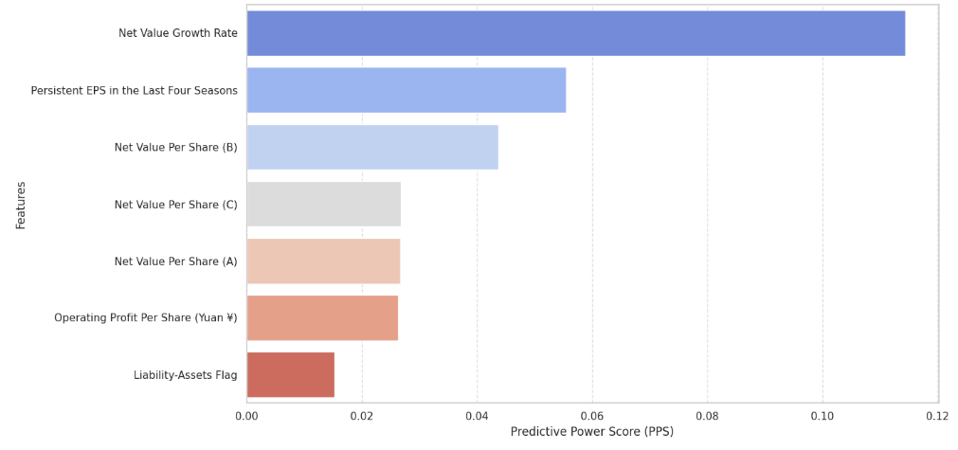
Predictive Power Score (PPS)

Slide 17
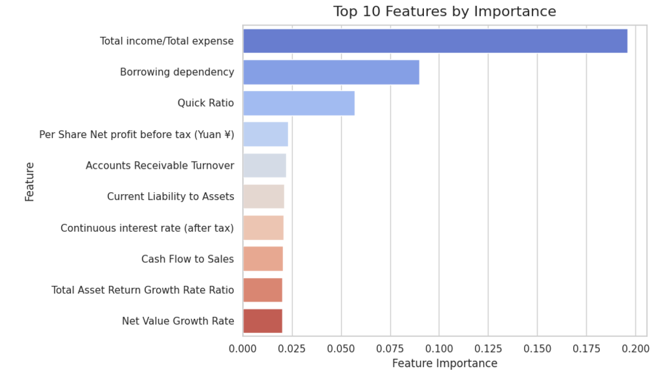
Decision Tree

Slide 18
Total Feature Selected
Selected features :
['Borrowing dependency', 'Liability-Assets Flag', 'Net Value Growth Rate', 'Net Value Per Share (A)', 'Net Value Per Share (B)', 'Net Value Per Share (C)', 'Operating Profit Per Share (Yuan ¥)', 'Persistent EPS in the Last Four Seasons', 'Quick Ratio', 'Total income/Total expense']
Number of features selected :
10

Slide 19
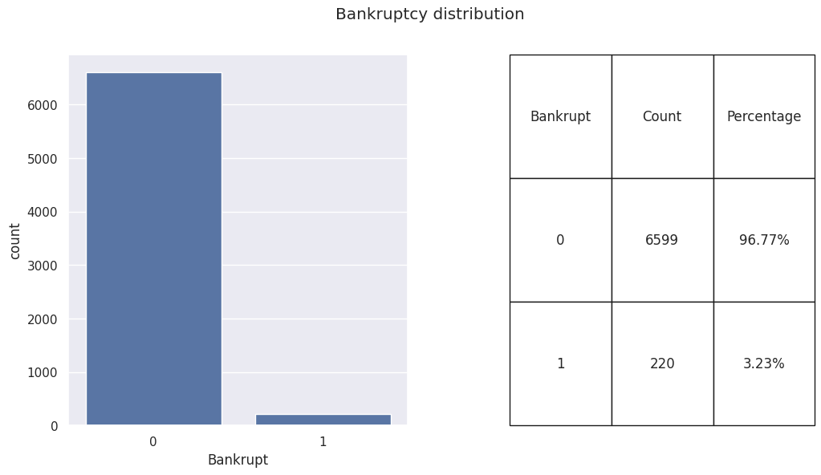
Bankruptcy Distribution

Slide 20
Handle Data Imbalance
1. Split the data into training and testing sets.
2. Set a sampling ratio between 0 and 1, increasing by 0.1 at each step. For each step:
- Select different sampling methods: Random Oversampler, SMOTE, ADASYN, SMOTEENN, SMOTETomek.
- Apply each algorithm to oversample the training data.
- Train a Decision Tree model and check its performance on the test data.
3. Choose the sampling method that gives the best overall results.

Slide 21
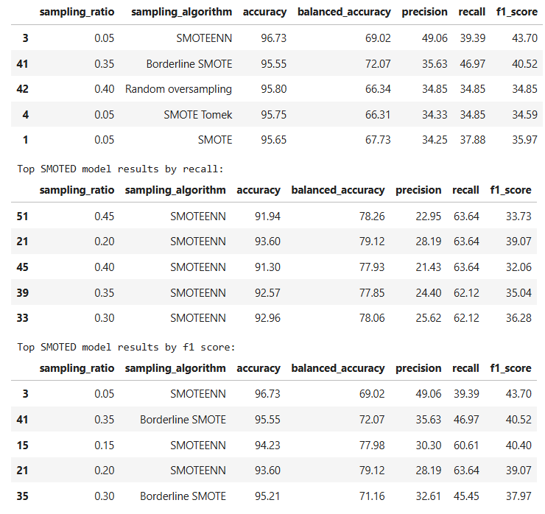
Handle Data Imbalance Result
SMOTE ENN performs the best in terms of accuracy, recall and f1.

Slide 22
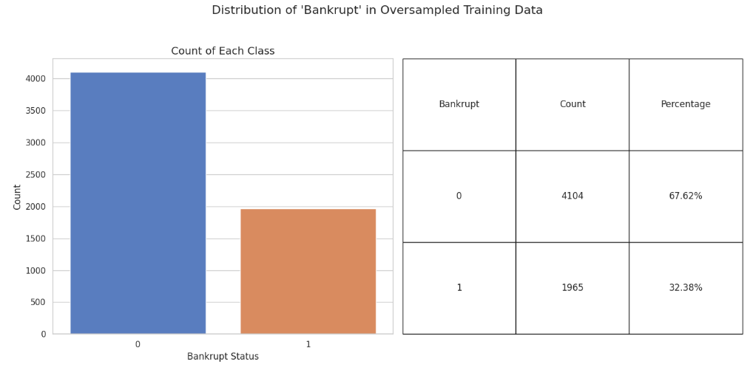
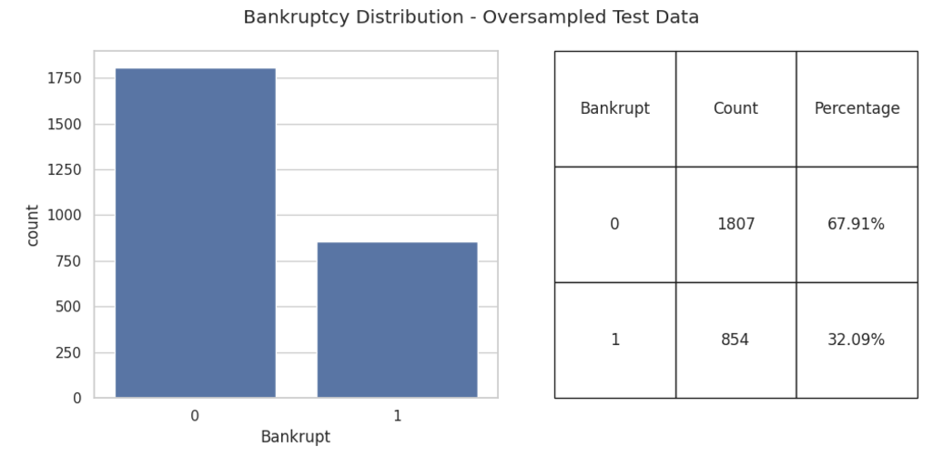
Bankruptcy Distribution

Slide 23
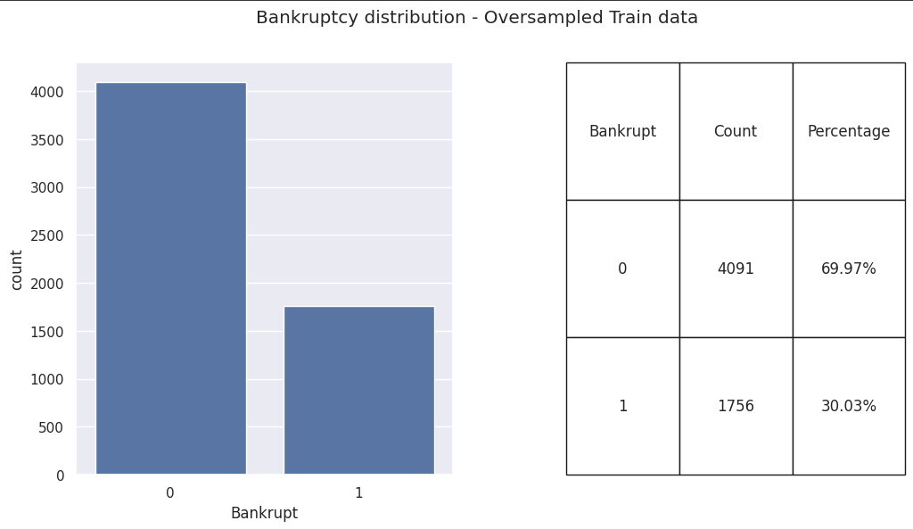
Bankruptcy Distribution

Slide 24

Outliers
In our dataset, only 3.23% of companies are bankrupt.
Bankruptcy is a rare occurrence in stable economic conditions and can be considered an outlier event.
Removing these outliers may result in the loss of valuable information. Therefore, we will retain all data points, including outliers.

Slide 25
04
ML Model

Slide 26
Choose ML Model
we will choose
LGBM Classifier for High performance in tabular data
Random Forest for the Robustness
XGBoost cause it is known for its high accuracy, making it a favorite in machine learning competitions.

Slide 27
Result
 |  |  | Random Forest | LGBM | XGBoost
Accuracy |  |  | 0.90 | 0.90 | 0.90
0 |  | Precision | 0.89 | 0.89 | 0.89
 |  | Recall | 0.97 | 0.97 | 0.96
 |  | F1 | 0.93 | 0.93 | 0.93
1 |  | Precision | 0.94 | 0.93 | 0.92
 |  | Recall | 0.75 | 0.76 | 0.76
 |  | F1 | 0.83 | 0.83 | 0.83

Slide 28
05
Conclusion

Slide 29
Conclusion
Given the similar overall performance, LGBM Classifier stands out slightly due to its higher precision and balanced recall, making it the most promising model for Bankruptcy Prediction.

Slide 30

Thanks!
Do you have any questions?

